Slide 1
The microcanonical ensemble
Finding the probability distribution
We consider an isolated system in the sense that
the energy is a constant of motion.
We are not able to derive ρ from first principles
Two typical alternative approaches
Postulate of Equal a Priori Probability
Use (information) entropy as starting
concept
Construct entropy expression from it and
show that the result is consistent
with thermodynamics
Derive ρ from maximum entropy
principle

Slide 2
Information entropy*
*Introduced by Shannon. See textbook and E.T. Jaynes, Phys. Rev. 106, 620 (1957)
Idea: Find a constructive least biased criterion for setting up probability
distributions on the basis of only partial knowledge (missing information)
What do we mean by that?
Let’s start with an old mathematical problem
Consider a quantity x with discrete random values
Assume we do not know the probabilities
We have some information however, namely
and we know the average of the function f(x) (we will also consider cases
where we know more than one average)
With this information, can we calculate an average of the function g(x) ?
To do so we need all the
but we have only the 2 equations
and
we are lacking (n-2) additional equations

Slide 3
What can we do with this underdetermined problem?
There may be more than one probability distribution creating
We want the one which requires no further assumptions
We do not want to “prefer” any p_{i} if there is no reason to do so
Information theory tells us how to find this unbiased distribution
(we call the probabilities now ρ rather than p)
Shannon defined information entropy, S_{i}:
or
for continuous distribution
with normalization
We make plausible that:
- S_{i} is a measure of our ignorance of the microstate of the system.
More quantitatively
- S_{i} is a measure of the width of the distribution of the ρ_{n}.

Slide 4
Let’s consider an extreme case:
An experiment with N potential outcomes (such as rolling dice)
However:
Outcome 1 has the probability ρ₁=1
Outcome 2,3,… ,N have ρ_{n}=0
-Our ignorance regarding the outcome of the experiment is zero.
-We know precisely what will happen
- the probability distribution is sharp (a delta peak)
Let’s make the distribution broader:
Outcome 1 has the probability ρ₁=1/2
Outcome 2 has the probability ρ₂=1/2
Outcome 3,4, … ,N have ρ_{n}=0
Let’s consider the more general case:
Outcome 1 has the probability ρ₁=1/M
Outcome 2 has the probability ρ₂=1/M
.
.
.
Outcome M has the probability ρ_{M}=1/M
Outcome M+1, … ,N have ρ_{n}=0

Slide 5
So far our considerations suggest:
Ignorance/information entropy increases with increasing width of the distribution
Which distribution brings information entropy to a maximum
For simplicity let’s start with an experiment with 2 outcomes
Binary distribution with ρ₁, ρ₂ and ρ₁+ ρ₂=1
with
maximum
uniform distribution

Slide 6
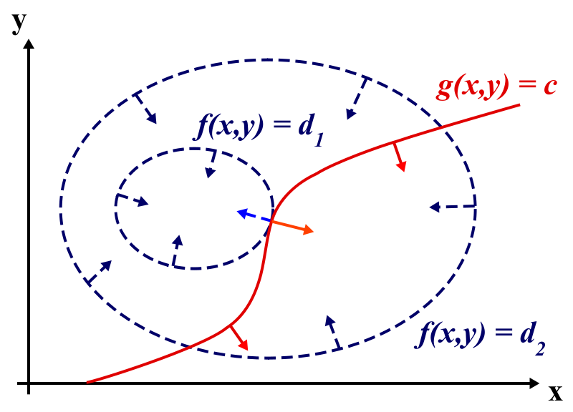
Lagrange multiplier technique
Once again
with
at maximum
constraint
From
http://en.wikipedia.org/wiki/File:LagrangeMultipliers2D.svg
Finding an extremum of f(x,y) under the constraint g(x,y)=c.
uniform distribution
Let’s use Lagrange multiplier technique to find distribution that maximizes

Slide 7
uniform distribution
maximizes entropy
with
In a microcanonical ensemble where each system has N particles, volume V
and fixed energy between E and E+Δ the entropy is at maximum in equilibrium.
- When identifying information entropy with thermodynamic entropy
Distribution function
Where Z_{Δ}(E) = # of microstate with energy in [E,E+ Δ]
called the partition function of the microcanonical ensemble

Slide 8
Information entropy and thermodynamic entropy
When identifying k=k_{B}
has all the properties we expect from the thermodynamic entropy
(for details see textbook)
We show here S is additive
probability distribution
for system 1
S₁
S₂
probability distribution
for system 2
Statistically independence of system 1 and 2
probability of finding system 1 in state n and system 2 in state m

Slide 9
Relation between entropy and the partition function Z_{Δ}(E)
1
Derivation of Thermodynamics in the microcanonical Ensemble
Where is the temperature ?
In the microcanonical ensemble the energy, E, is fixed
and
with

Slide 10
Let’s derive the ideal gas equation of state from the microcanonical ensemble
despite the fact that there are easier ways to do so
p
U+ Δ
Major task: find Z_{Δ}(U) :=# states in energy shell [U,U+ Δ]
U
q
another leftover from qm: phase space quantization, makes Z_{Δ} a dimensionless #
“correct Boltzmann counting”
requires qm origin of indistinguishability of atoms
We derive it when discussing the classical limit of qm gas
Solves Gibb’s paradox
For a gas of N non-interacting particles we have

Slide 11
3N dim. sphere
in momentum space
Remember:

Slide 12
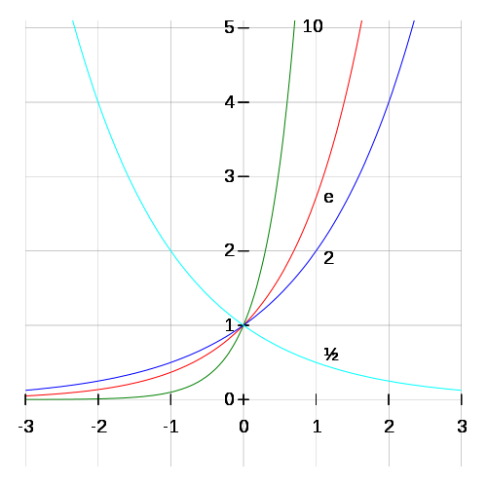
In the thermodynamic limit of
for
ln1=0
http://en.wikipedia.org/wiki/Exponentiation
with

